Slide 1
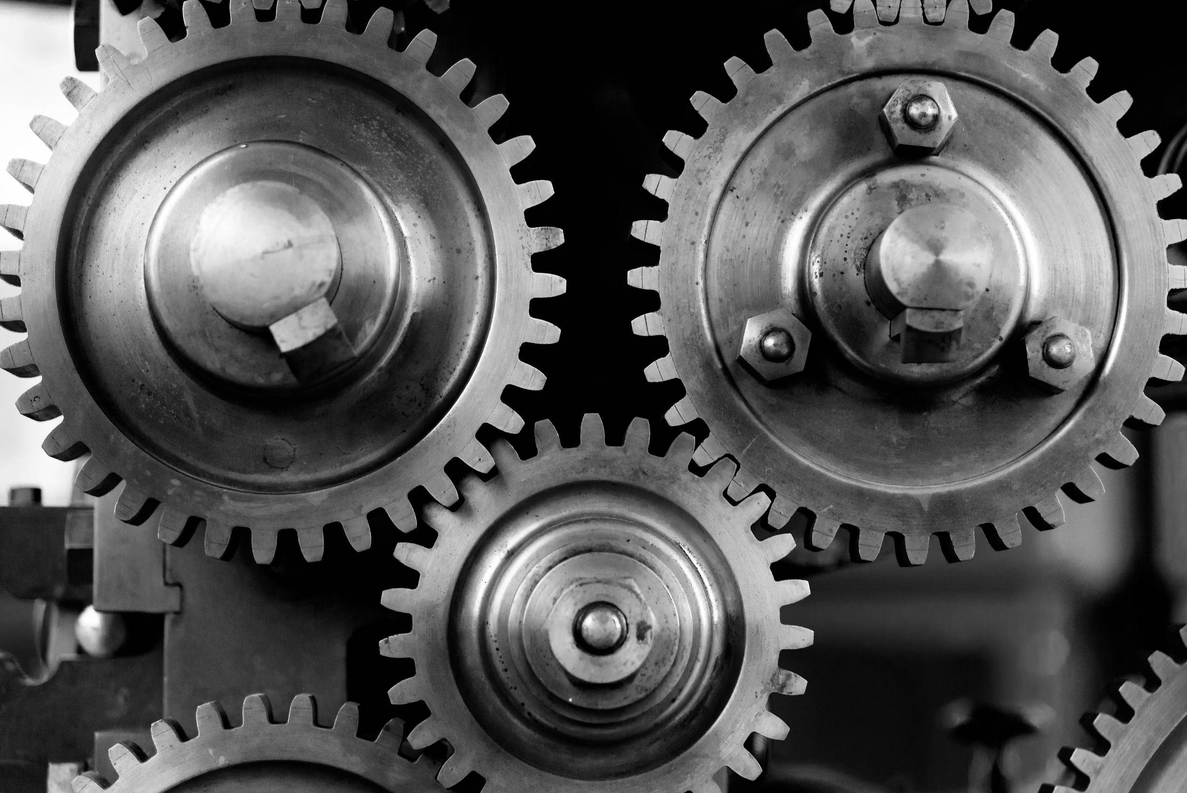
The Underpinnings of ML
Notes:
Welcome to the chapter the underpinnings of ML. This chapter will go a little deeper into Machine Learning, by focussing on

Slide 2
How algorithms work
The Underpinnings of ML
Notes:
how algorithms work.

Slide 3
How algorithms work
Explore important algorithms
The Underpinnings of ML
Notes:
We will explore the important algorithms and

Slide 4
How algorithms work
Explore important algorithms
Internal working
The Underpinnings of ML
Notes:
their internal working in simple words using

Slide 5
How algorithms work
Explore important algorithms
Internal working
Using real-life examples
The Underpinnings of ML
Notes:
real-life examples without any maths or coding.

Slide 6
How algorithms work
Explore important algorithms
Internal working
Using real-life examples
Concepts
The Underpinnings of ML
Notes:
We will learn concepts like

Slide 7
How algorithms work
Explore important algorithms
Internal working
Using real-life examples
Concepts
Linear Regression
The Underpinnings of ML
Notes:
Linear Regression

Slide 8
How algorithms work
Explore important algorithms
Internal working
Using real-life examples
Concepts
Linear Regression
Decision Trees
The Underpinnings of ML
Notes:
Decision Trees and

Slide 9
How algorithms work
Explore important algorithms
Internal working
Using real-life examples
Concepts
Linear Regression
Decision Trees
Neural Networks
The Underpinnings of ML
Notes:
Neural Networks.

Slide 10



Data
Algorithm
Model
Typical ML Process > Training
Notes:
In earlier chapters, we learnt that we feed the data having instances with features along with the expected output to the algorithm which generates the model.

Slide 11


Live Data
Data
Algorithm
Model
Prediction
Typical ML Process > Predictions
Notes:
Then, this generated model can predict the output from the live data or the input for which we don't know the labels.

Slide 12
Live Data
Data
Algorithm
Model
Prediction
Typical ML Process > Model and Algorithm
Notes:
But what is there in the algorithm that generates the model? And what does a model mean? Let's try to answer these questions.

Slide 13
Predicting salary based on the number of years of experience
Notes:
Let us take a really simple example of predicting the salary based on the number of years of experience.

Slide 14
2000
Predicting Salary
Notes:
Say, after the first year, your salary was 2000. And after the second year,

Slide 15
2000, 4000
Predicting Salary
Notes:
your salary became 4000,

Slide 16
2000, 4000, 6000
Predicting Salary
Notes:
and the third year 6000

Slide 17
2000, 4000, 6000, ______
Predicting Salary
Notes:
What will be your salary in the fourth year

Slide 18
2000, 4000, 6000, 8000
Predicting Salary
Notes:
That's right, it's 8000.

Slide 19
Let's formulate the machine learning problem..
Historical Data
Years of Experience | Salary
1 | 2000
2 | 4000
3 | 6000
Predicting Salary
Notes:
Let us convert this problem into instances, features, and labels and see how to make the computers solve this problem.
In our case, there is one feature "years of experience". In real life, there could be multiple features such as the area of expertise, the location etc. And there is one target or label - Salary.

Slide 20
Let's formulate the machine learning problem..
Historical Data
Years of Experience | Salary
1 | 2000
2 | 4000
3 | 6000
Training
Model
Predicting Salary
Notes:
We would want to train a model

Slide 21
Let's formulate the machine learning problem..
Unknown Salary
Years of Experience | Salary
4 | ???
Historical Data
Years of Experience | Salary
1 | 2000
2 | 4000
3 | 6000
Training
Model
Predicting Salary
Notes:
such that the model can predict the salary for the fourth year.

Slide 22
Let's formulate the machine learning problem..
Unknown Salary
Years of Experience | Salary
4 | ???
Historical Data
Years of Experience | Salary
1 | 2000
2 | 4000
3 | 6000
Training
Model
Years of Experience | Salary
4 | 8000
Prediction
Predicting Salary
Notes:
Here, the model has predicted the salary for 4 years of experience as 8000.
Now, let us understand what goes into training it.

Slide 23
How would a computer do it? - plot it
6000
Salary
4000
2000
1
2
3
→ Years
Predicting Salary
Notes:
A simple way to solve it is to just plot it on a chart. The horizontal axis being years of experience, and vertical axis being the salary.

Slide 24
How would a computer do it? - plot it
6000
Salary
4000
2000
1
2
3
→ Years
Predicting Salary

Slide 25
How would a computer do it? - plot it
6000
Salary
4000
2000
1
2
3
→ Years
Predicting Salary

Slide 26
How would a computer do it? - plot it
6000
Salary
4000
2000
1
2
3
→ Years
Predicting Salary

Slide 27
How would a computer do it? - plot it
6000
Salary
4000
2000
1
2
3
→ Years
Predicting Salary
Notes:
And once we are done with plotting, ...

Slide 28
Ask the plot for the salary in 4th yr!
6000
Salary
4000
2000
1
2
3
4
→ Years
Predicting Salary
Notes:
… we can figure out the salary for the 4th year ...

Slide 29
It is correct!
8000
6000
Salary
4000
2000
1
2
3
4
→ Years
Predicting Salary
Notes:
… which turns out to be 8000. Here we were lucky to have perfect data with which we could draw a straight line.

Slide 30
Life isn't perfect! You never get straight line!
6020
3980
2010
1
2
3
Predicting Salary
Notes:
What if our data was more like real-world data where we don't always get a perfect line? Say if the salaries for the three years were 2010, 3980, 6020? Can we draw a straight line that passes through all the points? No, we can't.
So, what do we do in this case? How do we figure out the salary for the fourth year?

Slide 31
Linear Regression - Find best fitting line
6020
3980
2010
Predicting Salary
1
2
3
Notes:
The first strategy is to come up with a straight line that is closest to all the points. This approach is known as linear regression. Though, there are various other ways to do prediction which we will talk about later. For now, what could be the definition of the best fitting line? The best fitting line or line of best fit is a line which is closest to all the points. Meaning, it has minimum error. So, we could find the average of total deviations. And we can calculate the total deviation either by summing up the absolute differences or the squares of differences. And find a line which has the minimum error.

Slide 32
Normal Equation - Mathematically
Line 1
6020
Line 2
3980
2010
Line 3
Predicting Salary
1
2
3
Notes:
Let us visualize the error. In this diagram, line 1 has the minimum error and hence it is the best line as compared to line 2 and 3.
So, our machine learning algorithm needs to come up with such a line which has the minimum error. Each line is basically a model. The model or line that algorithm comes up will be used for predictions.

Slide 33
Try multiple lines! Whichever is closer.
Line 1
6020
Line 2
3980
2010
Line 3
Predicting Salary
1
2
3
Notes:
We could create a simple algorithm that iterates over all possible lines and keeps the best line so far. Such an algorithm will basically try lines with all possible slopes and distances from the center.
What do you think is the challenge with this? It will take a huge amount of time to come up with the best model even in such a simple case.
Why not try to go to the side where the error is reducing?

Slide 34
Gradient Descent
Notes:
One such approach is Gradient Descent. Let's understand this approach.

Slide 35
Gradient Descent - A little greedy approach.
6020
Initial Guess
3980
2010
1
2
3
4
Gradient Descent
Notes:
Say, we start with a random line with some slope and intercept.

Slide 36
Gradient Descent - find impact of slight change
6020
Try Increasing the slope a little bit
Initial Guess
3980
2010
1
2
3
4
Gradient Descent
Notes:
And then we try increasing the slope a little bit and observe the change in error due to the change in the slope. Here we have three instances 2010, 3980 and 6020. To compute the change in error we will have to check with all the instances.

Slide 37
Gradient Descent - guess next line!
Next line
6020
Try Increasing the slope a little bit
Initial Guess
3980
2010
1
2
3
4
Gradient Descent
Notes:
If the error is decreasing, we continue to increase slope at a faster pace.

Slide 38
Gradient Descent
Increase in slope is proportional to Rate of decrease of error w.r.t change in slope
Next line
6020
Initial Guess
3980
Try Increasing the slope a little bit
2010
1
2
3
4
Gradient Descent
Notes:
The question is how much should we change the slope to get the next line after each probe? In simple words, the increase in the slope should be proportional to the rate of decrease in error. The more the change in error, the more we should change the slope.

Slide 39
Gradient Descent
Increase in slope = learning rate * Rate of decrease of error wrt change in slope
Next line
Some constant.
6020
Initial Guess
3980
Try Increasing the slope a little bit
2010
1
2
3
4
Gradient Descent
Notes:
So, we can say that the increase in slope is equal to some constant multiplied by the rate of decrease in error. Please note that this decrease in error is with respect to the change in slope.

Slide 40
Gradient Descent
New Slope = Old Slope + Learning Rate * Rate of decrease of error wrt change in slope
Next line
6020
Initial Guess
3980
Try Increasing the slope a little bit
2010
1
2
3
4
Gradient Descent
Notes:
So, now we can say that the new slope is equal to the old slope plus the change. And the change is learning rate which is some constant number multiplied by the rate of decrease in error.

Slide 41
Try Increasing the slope a little bit
Initial Guess
Next line
6020
3980
What if error increased due to increasing slope?
2010
1
2
3
4
Gradient Descent
Notes:
If the error is increasing with increasing slope, we decrease the slope as in the diagram.
This method is called gradient descent. Gradient means the rate of change and descent means going down. We go to the side where the gradient of error is going down.
Since a line is defined by slope and its distance from the center is called intercept, we do the same tweaking for the intercept too.

Slide 42
Gradient Descent
Start with random line
Gradient Descent > Flowchart
Notes:
Since the gradient descent is the core algorithm in machine learning and deep learning, we would spend more time on this. Say, we are trying to find a line that fits our data points.
We start with a random line. Here the line is our model because using this line we will be doing the prediction of salaries as we did earlier.

Slide 43
Gradient Descent
Start with random line
Increase the slope a bit
& Calculate change in error
Did the error decrease?
Gradient Descent > Flowchart
Notes:
We then slightly increase the slope and calculate the change in error. Also, notice that to compute the change in error we will have to consult all the training instances.

Slide 44

Gradient Descent
Start with random line
Increase the slope a bit
& Calculate change in error
Did the error decrease?
Yes
Increase the slope.
Gradient Descent > Flowchart
Notes:
If the error decreased due to increasing the slope, we continue to increase the slope in a greater amount proportional to the rate of change.

Slide 45

Gradient Descent
Start with random line
Increase the slope a bit
& Calculate change in error
Did the error decrease?
Decrease the slope.
No. Error
increased
Yes
Increase the slope.
Gradient Descent > Flowchart
Notes:
Otherwise if the error has increased, we go in the opposite direction that decreases the slope in the proportion of the rate of change. Larger the change in error per change in slope, larger the tweaking we do in the slope.

Slide 46
Gradient Descent
Start with random line
Increase the slope a bit
& Calculate change in error
Did the error decrease?
Decrease the slope.
No. Error
increased
Yes
Increase the slope.
No, Error didn't change
Stop, you have found the best line
Gradient Descent > Flowchart
Notes:
If the error didn't change due to change in slope, we stop because we have probably found a line that is the best fit.

Slide 47
Gradient Descent
Start with random line
Increase the slope a bit
& Calculate change in error
Next epoch / iteration
Next epoch / iteration
Did the error decrease?
Decrease the slope.
No. Error
increased
Yes
Increase the slope.
No, Error didn't change
Stop, you have found the best line
Gradient Descent > Flowchart
Notes:
Afterwards, we go back to tweaking the slope again. It is called the next epoch or next iteration. We continue doing it until we find that the error is no longer changing due to tweaking. The model is the line which has two parameters - slope and the intercept. Also note that the way we tweaked the slope, we would be tweaking the intercept too.

Slide 48
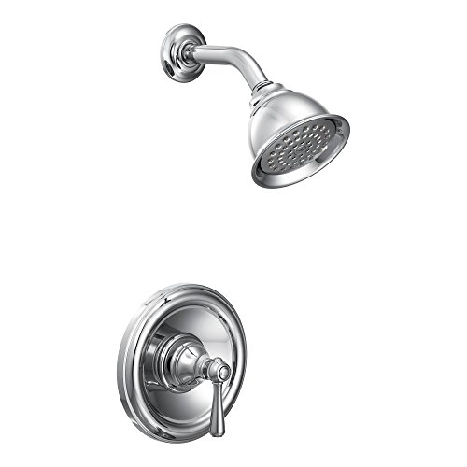
Gradient Descent
Gradient Descent > Tap Analogy
Notes:
Let us take one more example to understand the gradient descent. Say, you checked into a new hotel in winter and you have to take bath. Also, you don't know which side you should be rotating the knob to, to give cold and hot water.
What would you do in order to get the best temperature of water for yourself?
Think for a moment.
One approach could be that we start with the knob at the extreme left and try all orientations. But that would take too much time as well as it would waste lots of water. Could you think of a better approach?
Please take a moment to think.

Slide 49
Gradient Descent
Gradient Descent > Tap Analogy
Notes:
Alright, so this is what we would do if we follow the gradient descent algorithm. We will start somewhere in the middle or any other random position of the knob. Check the water if it is of the right temperature. If it is, then, there is no point in tweaking further, you have found a comfortable temperature. And you can take bath.
If the temperature of the water is not comfortable to you, either because it is too hot or too cold, you would like to tweak the position of the knob.

Slide 50
Gradient Descent
Gradient Descent > Tap Analogy
Notes:
Now, you slightly rotate the knob to the right and check if the temperature is going towards your comfortable side.

Slide 51
Gradient Descent
New Position
Gradient Descent > Tap Analogy
Notes:
Then rotate it in the same direction by a larger amount.

Slide 52
Gradient Descent
Begin Again!
Gradient Descent > Tap Analogy
Notes:
And afterward, we continue the same process again.

Slide 53
Gradient Descent
New Position
Slight right twist
Gradient Descent > Tap Analogy
Notes:
If in the previous step, rotating slightly to the right was taking the temperature of the water to uncomfortable side (either too hot or too cold), we would twist the knob to the left by a large amount.

Slide 54
What if we had two knob?
Comfortable position
Gradient Descent > Tap Analogy
Notes:
Once we have found the comfortable position, we can mark the angle and this is what we call our model. This particular model has only one weight that is an angle. The algorithm that we used was gradient descent. In machine learning, we make the computer use the gradient descent to tweak the model such that the model starts performing well first on the training set and then on the test set. Also, notice that once you have trained the model, running it is generally very fast. Only the training takes time.

Slide 55
What if we had two knob?
Gradient Descent > Two Knobs
Notes:
Now, let us extend the same example to two knobs. What if we have two knobs - Maybe one for cold water and other for hot water but you don't know which one is which. Now, in this case, you will have to tweak both the knobs simultaneously in order to get the right flow and comfortable temperature. So, in this model, how many weights do we have? two , right?

Slide 56
Gradient Descent
Gradient Descent > Two Knobs
Notes:
At the end of training or tweaking, we would get the two positions of the knobs. In this model, we would be able to get two outputs - the right water flow and a good temperature but we have more weights to train and hence the training will take more time.

Slide 57
Weights
Hot
Good Flow
Right Temperature
Cold
Input
Model
Output
Gradient Descent > Model
Notes:
We can represent the same using this diagram.

Slide 58
What if we had more input features?
Weights
Climate
Gender
Good Flow
Country
Right Temperature
Hot
Cold
Input
Model
Output
Gradient Descent > Model
Notes:
What if we had more parameters such as climate, person’s details, and the input temperature. In that case, we would require a lot more weights or knobs and the model will be very complex.

Slide 59

Decision Trees
Underpinnings
Notes:
Now let’s take a look at a different way of solving machine learning problems. It’s called Decision trees.

Slide 60

Decision Tree
Decision Tree > Overview
Notes:
Even if we are not aware, we make hundreds of decisions based on simple conditional statements in our day-to-day life. Decision trees are just an extension of this way of making decisions. In the example on the screen, the decision tree is for deciding if I should accept a new job offer or not. First I check if the salary is at least fifty thousand dollars. If it is, then I check if the commute is more than 1 hour and then I check if it offers free coffee. So, based on these three questions I make a decision on whether to accept or reject the new job.

Slide 61
Decision Tree
Age | Salary
10 | 0
5 | 0
2 | 0
13 | 5
25 | 20
30 | 20
35 | 25
40 | 18
age | ?
Decision Tree > Example
Notes:
Let’s take a simple example to demonstrate the working of a decision tree. Suppose we have the data on age and salary, and we want to predict the salary, for a given age. Let's see how can we solve this problem using decision trees.

Slide 62
Decision Tree
Age | Salary
10 | 0
5 | 0
2 | 0
13 | 5
25 | 20
30 | 20
35 | 25
40 | 18
age | ?
Salary
Age
Decision Tree > Example
Notes:
First, let's visualize these data points on an age v/s salary graph.

Slide 63
Decision Tree
Age | Salary
10 | 0
5 | 0
2 | 0
13 | 5
25 | 20
30 | 20
35 | 25
40 | 18
age | ?
Age >= 25
Salary
Age < 25
Age
Decision Tree > Example
Notes:
A quick way to make the first level decision tree would be to split this data into two groups by drawing a vertical line somewhere in the middle of the age axis, say at age 25. Now we have a simple model that can predict the salary for a given age.

Slide 64
Decision Tree
Age | Salary
10 | 0
5 | 0
2 | 0
13 | 5
25 | 20
30 | 20
35 | 25
40 | 18
age | ?
Age >= 25
Salary
Age < 25
Average value of group
Age
Decision Tree > Example
Notes:
If we have to predict the salary of the person, identify which group he belongs to based on his age. If his age is greater than 25, then his salary will most probably be an average of ages of the group on the right side of the line.

Slide 65
Decision Tree
Age | Salary
10 | 0
5 | 0
2 | 0
13 | 5
25 | 20
30 | 20
35 | 25
40 | 18
age | ?
Age >= 25
Salary
Age < 25
Average value of group
Age
Decision Tree > Example
Notes:
And similarly, if the age is less than 25, then his salary would most probably be an average of the salaries of the group on the left of the line.

Slide 66
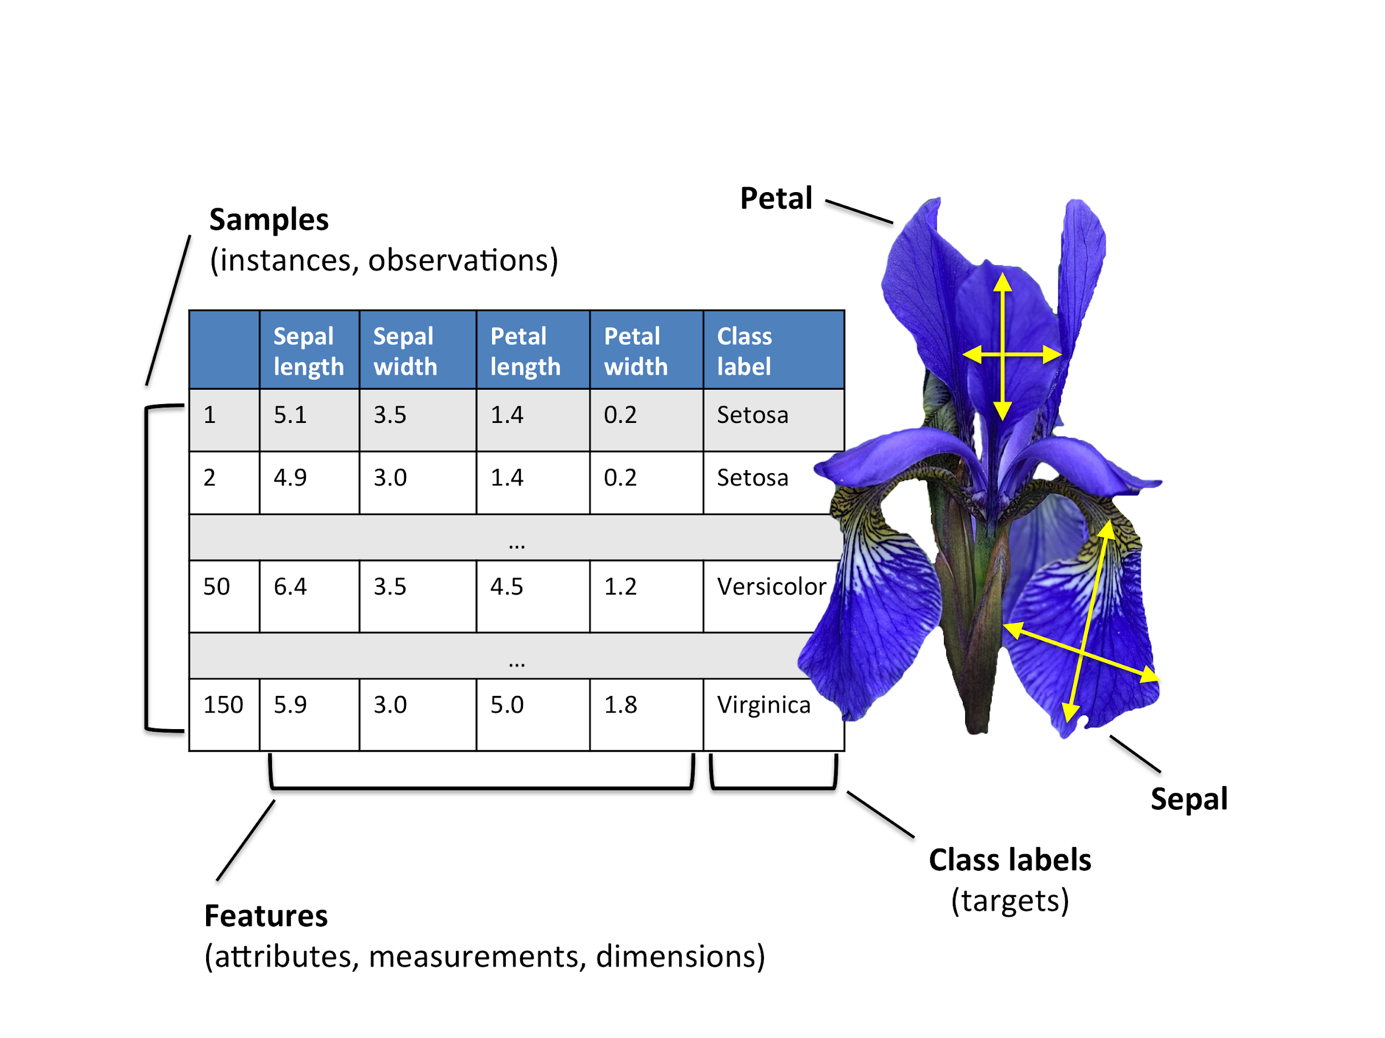
IRIS dataset
We’ll only use two features i.e. petal length and petal width.
Decision Tree > Iris Example
Notes:
Let’s take one more example. We will use the IRIS dataset here which contains 150 rows or instances and four columns or features. Each of these observations is labeled as one of the three flowers - Setosa ,Versicolor or Virginica. Let's see how can we use decision trees to identify a new instance of a flower.

Slide 67
IRIS dataset
We’ll only use two features i.e. petal length and petal width.
Decision Tree > Iris Example
Notes:
To make it simple, we will use only two features - petal length and petal width.

Slide 68
Decision Tree - IRIS dataset - Model
Petal length <= 2.45
Samples = 150
Value =[50,50,50]
Class =setosa
Decision Tree > Iris Example
Notes:
Using the first feature, the petal length, the algorithm has separated the flowers into two groups. One that has petal length lesser than 2.45 centimeters and the other that has greater than 2.45 centimeters.

Slide 69
Decision Tree - IRIS dataset - Model
Petal length <= 2.45
Samples = 150
Value =[50,50,50]
Class =setosa
Samples = 50
Value =[50,0,0]
Class =setosa
Decision Tree > Iris Example
Notes:
What the algorithm has done is that based on the petal lengths of all the flowers in the 150 observations, it used the number 2.45 as the boundary condition for grouping one class of flowers. We will see later how we come up with these limits. The flowers that have petal length lesser than 2.45 cms are classified as setosa.

Slide 70
Decision Tree - IRIS dataset - Model
Petal length <= 2.45
Samples = 150
Value =[50,50,50]
Class =setosa
Samples = 50
Value =[50,0,0]
Class =setosa
Petal width <= 1.75
samples = 100
Value =[0,50,50]
Class =versicolor
Decision Tree > Iris Example
Notes:
The flowers that have petal length greater than or equal to 2.45 cms are either Versicolor or virginica. So we need the next criteria such as the petal width being lesser than 1.75 cm, in this case, to separate the remaining two classes of flowers.

Slide 71
Decision Tree - IRIS dataset - Model
Petal length <= 2.45
Samples = 150
Value =[50,50,50]
Class =setosa
Samples = 50
Value =[50,0,0]
Class =setosa
Petal width <= 1.75
samples = 100
Value =[0,50,50]
Class =versicolor
Samples = 54
Value =[0,49,5]
Class = versicolor
Samples = 46
Value =[0,1,45]
Class = virginica
Decision Tree > Iris Example
Notes:
As per this model, if the petal width is less than 1.75 cms, we know that this flower is most probably versicolor and if it is greater than 1.75 cms, it is virginica. The same process can be visualized in the form of a graph.

Slide 72
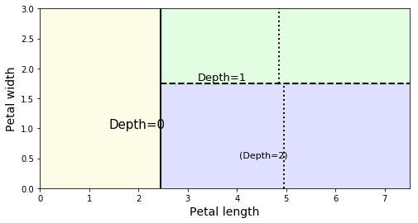
Decision Tree - Decision Boundaries
Petal width
Petal length
Decision Tree > Visualisation
Notes:
We start by plotting the graph of petal length v/s petal width

Slide 73
Decision Tree - Decision Boundaries
Boundary made at depth 0.
Petal length <= 2.45
Petal width
Petal length
Decision Tree > Visualisation
Notes:
Based on petal length, we draw the first boundary condition

Slide 74
Decision Tree - Decision Boundaries
setosa
Boundary made at depth 0.
Petal length <= 2.45
Petal width
Petal length
Decision Tree > Visualisation
Notes:
Any instance that comes to the left of the boundary, is a setosa.

Slide 75
Decision Tree - Decision Boundaries
Boundary made at depth 1.
Petal width <= 1.75
setosa
Petal width
Petal length
Decision Tree > Visualisation
Notes:
And then we draw the next boundary based on the next condition which is the petal width being less than 1.75.

Slide 76
Decision Tree - Decision Boundaries
Boundary made at depth 1.
Petal width <= 1.75
setosa
virginica
versicolor
Petal width
Petal length
Decision Tree > Visualisation
Notes:
The instances that come below the second boundary are versicolor and the ones that come above the second boundary are virginica.

Slide 77
Decision Tree - how does it work?
Salary
Age
Decision Tree > Algorithm
Notes:
Now that we have seen what a boundary condition is, let's understand how the algorithm actually comes up with the boundary condition. Let’s go back to the initial Age v/s Salary prediction problem. For ease of visualization, plot the points on the graph.

Slide 78
Decision Tree - how does it work?
Salary
It tries to find a boundary that separates similar instances. We go over all the features.
Pick a feature
Age
Decision Tree > Algorithm

Slide 79
Decision Tree - how does it work?
Salary
It tries to find a boundary that separates similar instances. We go over all the features.
Pick a feature
Pick some boundary value
Age
Decision Tree > Algorithm
Notes:
In order to find the right boundary value, the algorithm does the following steps. It first picks the feature Age and assigns a boundary value to begin with. Now we have two groups of data.

Slide 80
Decision Tree - how does it work?
Salary
It tries to find a boundary that separates similar instances. We go over all the features.
Pick a feature
Pick some boundary value
Find the similarity in instances on same side
Age
Decision Tree > Algorithm
Notes:
Then it checks the purity of the groups. i.e, it finds how many of the similar instances are grouped together and how many of the dissimilar instances are grouped wrongly. Here similarity is based on the salaries of people. The group having similar salaries is purer than the one having less similar salaries.

Slide 81
Decision Tree - how does it work?
Salary
It tries to find a boundary that separates similar instances. We go over all the features.
Pick a feature
Pick some boundary value
Find the similarity in instances on same side
If the similarity is better, keep it.
Go to step 1
Age
Decision Tree > Algorithm
Notes:
If the similarity or purity is best so far, it keeps the boundary and moves on to choosing a new boundary.

Slide 82
Decision Tree - how does it work?
Salary
It tries to find a boundary that separates similar instances. We go over all the features.
Pick a feature
Pick some boundary value
Find the similarity in instances on same side
If the similarity is better, keep it.
Go to step 1
Age
Decision Tree > Algorithm
Notes:
It selects the boundary from the next age and then checks the purity or similarity of both the groups.

Slide 83

Decision Tree - how does it work?
Salary
It tries to find a boundary that separates similar instances. We go over all the features.
Pick a feature
Pick some boundary value
Find the similarity in instances on same side
If the similarity is better, keep it.
Go to step 1
Age
Decision Tree > Algorithm
Notes:
And this way it finds the best model which separates the data into two groups such that the data in either side is very similar to each other.

Slide 84
Salary
age < 25
age < 13
age < 40
Age
Decision Tree > Algorithm
Notes:
Once we have found the best boundary, we can go further and divide the data on each side of the boundary in the same fashion. Every time we divide the data, we are basically creating a node in the tree and hence the depth of the tree keeps on increasing.
Also, notice that if we don't stop the decision tree from growing it will keep on dividing the data until it can't divide it further, that is, only one element is left in the group. This leads to overfitting because it would be able to do very precise predictions on known data but would not generalize well on the unknown data.

Slide 85
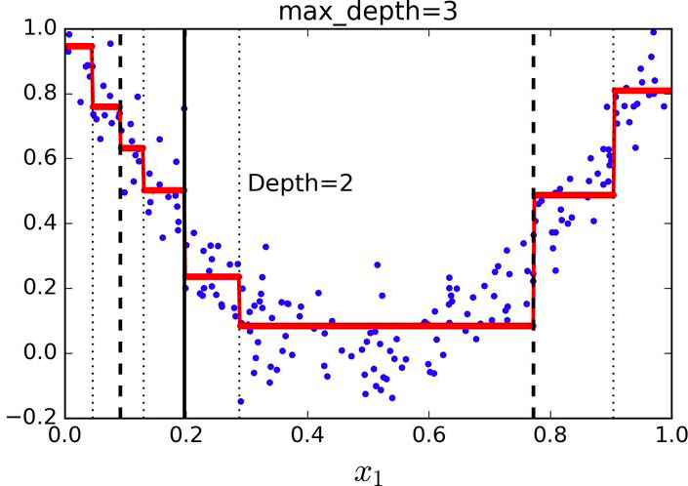
Decision Tree - Complex Models?
Decision Trees can come up with really complex models.
Decision Tree > Non Linear
Notes:
Here in this diagram, we are taking an example of the dataset where the outcome is non-linear. As the value of x is increasing the value of y first comes down and then it starts increasing. A straight line cannot be a good fit for such a dataset. But a decision tree is able to fit this data and it can do reasonable predictions.
In the diagram, the vertical lines represent the boundaries or nodes of the decision tree while the horizontal lines represent the average value of each bucket.
So, a decision tree is quite capable to do complex predictions that may not fit a straight line.

Slide 86
Decision Tree - Final Word
Easy to Visualize
Decision Tree > Summary
Notes:
We have seen that decision trees are very popular because they are easy to visualize, interpret and explain but if not designed properly, there is a high probability of overfitting or memorization.
In the situations where it is mandatory to be able to explain the model to various stakeholders, people prefer to use decision tree but controlled or regularized ones.

Slide 87
Decision Tree - Final Word
Easy to Visualize
Easy to Interpret & explain
Decision Tree > Summary
Notes:
In the situations where it is mandatory to be able to explain the model to various stakeholders, people prefer to use decision tree but controlled or regularized ones.

Slide 88
Decision Tree - Final Word
Easy to Visualize
Easy to Interpret & explain
If not designed well, ends up overfitting
Decision Tree > Summary

Slide 89
SVM
Notes:
We will be briefly covering another way of coming up with a model called the SVM. But before that let’s understand what linear classifiers are.

Slide 90
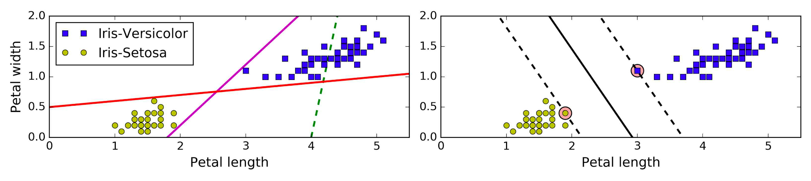
What is Linear Classification?
The two classes can be separated easily with a ‘straight’ line
Petal width
Petal length
Machine Learning > Supervised Learning > SVM > Linear Classification
Notes:
Consider the two classes - setosa and versicolor - from the iris dataset. We can visualize the two groups on the graph. If we are to separate these two groups of data points using one straight line, we can have multiple such straight lines to do so. Simple linear classifiers do exactly this - separating the groups using straight lines. Here in this graph, three sample lines are shown - red, violet and a dotted green. While the red and the violet lines do a moderately good job, the green or dashed one clearly does not do a good job at separating the two classes of data.

Slide 91
Is Linear Classification good enough?
Petal width
Petal length
Machine Learning > Supervised Learning > SVM > Linear Classification
Notes:
Now, let's focus on the two lines - red and violet which seem to do a good job. These lines are the linear models to classify the data.
Do you think these lines are the best one to separate the data?

Slide 92
Is Linear Classification good enough?
A
Petal width
Petal length
Machine Learning > Supervised Learning > SVM > Linear Classification
Notes:
What about the instance A. The violet line will classify A as setosa even though it is very close to the versicolor.

Slide 93
Is Linear Classification good enough?
A
Petal width
B
Petal length
Machine Learning > Supervised Learning > SVM > Linear Classification
Notes:
And what about B, the red line will classify the instance B as versicolor even though it was supposed to be setosa.
So, neither of these lines are generalizing well.

Slide 94
Is Linear Classification good enough?
How about this line?
A
Petal width
B
Petal length
Machine Learning > Supervised Learning > SVM > Linear Classification
Notes:
How about the dotted black line? Will it be better than the violet and red line?
Will it be able to classify instance A and instance B really well? Yes, of course.
So, just coming up with lines that able to separate the existing instances is not good enough. We need to come up with a line or a model that separates the classes with maximum margin. This is what our next topic SVM is about.

Slide 95
What is Linear Classification?
Petal width
Petal length
‘Straight’ is the keyword. It means linear classification.
Machine Learning > Supervised Learning > SVM > Linear Classification
Notes:
Now let’s compare this to another classifier called Support Vector Machines or SVM in short. Instead of just trying to separate the two groups, like a simple linear classifier, SVM tries to MAXIMISE the boundaries between the groups.

Slide 96
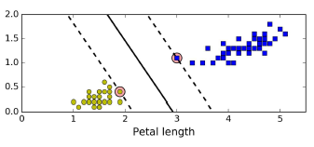
What is Linear Classification?
Widest possible street
Petal Width
Machine Learning > Supervised Learning > SVM > Linear Classification
Notes:
You can imagine the algorithm trying to fit the widest possible street between the two groups such that the two sides of the streets touch one of the boundary instances in each of the group. This is also called the large margin classification. Adding new training instances which are away from the boundary condition does not affect the model since the model only depends on the instances which are on the edge of the boundary.

Slide 97
What is Linear Classification?
Widest possible street
Petal Width
Support Vectors
Machine Learning > Supervised Learning > SVM > Linear Classification
Notes:
These boundary instances are called support vectors, hence the name Support Vector machines.

Slide 98
What is Linear Classification?
Widest possible street
Petal Width
Support Vectors
Model
Machine Learning > Supervised Learning > SVM > Linear Classification
Notes:
The model, in this case, is the central line of the street. Using this middle line, we make the predictions.

Slide 99
Linear SVM Classification - Large Margin
Violet and red decision boundaries are very close to the instances - bad model | Decision Boundary as far away from training instances - good model
Large Margin Classification
Machine Learning > Supervised Learning > SVM > Linear Classification > Large Margin
Notes:
Why is linear SVM better than the simple linear classifiers?
The instances in the simple linear classifier come so close to the boundary lines that, there might be a chance that a new instance might fall in either side of the classifier, and so might not perform well on unseen data.
In SVM, on the other hand, because the decision boundaries are as far as possible between the two groups, there is a lesser chance that a new instance will fall into a wrong group, therefore ensuring better performance on new instances.

Slide 100
How does SVM work?
Petal Width
Machine Learning > Supervised Learning > SVM
Notes:
Now, that we established if we can come up with a maximum margin street between the instances, we would get a better model. The question is how to come up with such a street. There are two ways, one is mathematical and other is using gradient descent. The gradient descent way should be clear to you - all it will be doing is come up a random street, tweak it little and see the impact. If the impact is positive, keep going otherwise go in the opposite direction.
The mathematical way is really fast and used if you have very few instances. We would not be going into the mathematical way here.

Slide 101
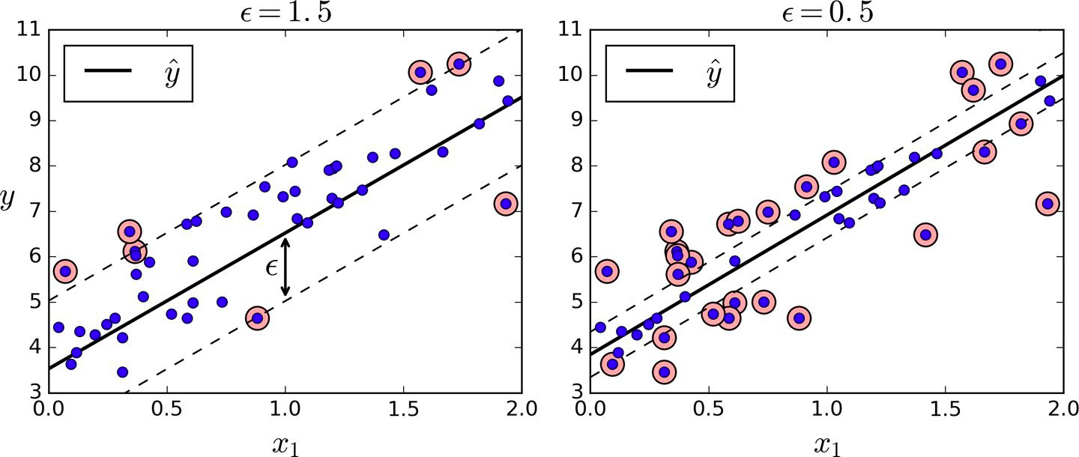
SVM Regression
SVM Classifier | SVM Regression
Find the largest possible street between the two classes limiting margin violations | Fit as many instances as possible on the street while limiting margin violations
Widest possible street
Machine Learning > Supervised Learning > SVM > SVM Regression
Notes:
Just like decision trees and linear models, the SVM can be used for regression along with classification.
In classification, the street should be widest such that it separates the instances well and in regression, the street should be narrowest such that it includes the instances well.

Slide 102
Can we solve it with SVM regression?
6020
3980
2010
1
2
3
4
Machine Learning > Supervised Learning > SVM > SVM Regression
Notes:
If we go back to our original problem of finding salary in the fourth year, how will the SVM solve it?

Slide 103
Find narrowest street that can fit the data points
6020
3980
2010
1
2
3
4
Machine Learning > Supervised Learning > SVM > SVM Regression
Notes:
We will first come up with the support vectors that gives the narrowest street such that all the data points are well within the street.
There are multiple streets, possible but one shown here seems to be optimum.

Slide 104
Central line of street is your model!
6020
3980
2010
1
2
3
4
Machine Learning > Supervised Learning > SVM > SVM Regression
Notes:
Once we have come up with the street, we can draw the central line ...

Slide 105
Using the model we can do predictions...
6020
3980
2010
1
2
3
4
Machine Learning > Supervised Learning > SVM > SVM Regression
Notes:
… which can be used for prediction.

Slide 106
This is your salary in 4th year
6020
3980
2010
1
2
3
4
Machine Learning > Supervised Learning > SVM > SVM Regression
Notes:
This is your salary in fourth year.

Slide 107
SVM
Very powerful and versatile model
Capable of performing
Classification
Regression
Outlier detection
Before neural networks, they were best performing
Well suited for small or medium sized datasets
Machine Learning > Supervised Learning > SVM > Summary
Notes:
To sum up, SVMs are very versatile, since they are can be used for classification, regression and outlier detection.
Since SVMs focus on fixing the boundaries using a minimum number of data points, they are ideal candidates as models when we are dealing with small and medium datasets.

Slide 108
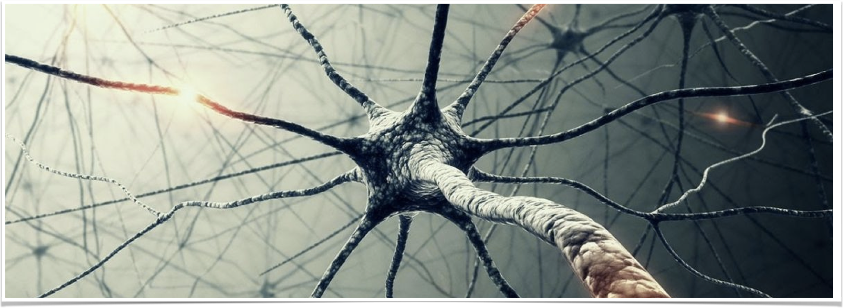
Deep Learning - Artificial Neural Network(ANN)
Computing systems inspired by the biological neural networks that constitute animal brains.
Deep Learning > Artificial Neural Network (ANN)
Notes:
Now let's try to understand Neural networks - the algorithm fashioned based on the workings of an animal brain. In the recent past, the artificial neural networks are doing an incredible job in predicting.

Slide 109
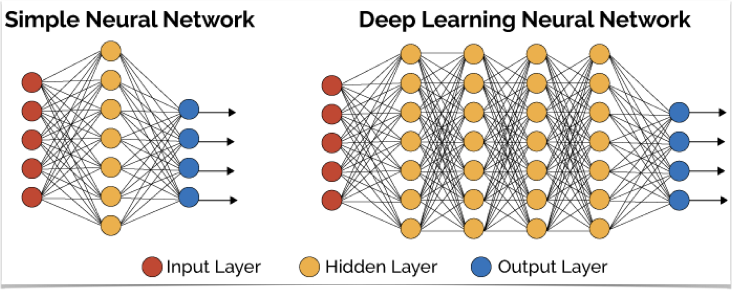
Multiple layers of neurons
Deep Learning > Simple Neural Network (ANN) > Deep Learning Neural Network (DNN)
Notes:
This is a simple representation of how neurons are connected to each other.
Notice that all inputs are connected to all neurons… and each neurons is also connected to other neurons.

Slide 110
Multiple layers of neurons
Deep Learning > Simple Neural Network (ANN) > Deep Learning Neural Network (DNN)
Notes:
Here the input layer is represented in red

Slide 111
Multiple layers of neurons
Deep Learning > Simple Neural Network (ANN) > Deep Learning Neural Network (DNN)
Notes:
and the output layer is represented in blue .

Slide 112
Multiple layers of neurons
Deep Learning > Simple Neural Network (ANN) > Deep Learning Neural Network (DNN)
Notes:
A simple neural network has only one layer of neurons between the input and the output, otherwise known as the hidden layer. And a deep neural network has many hidden layers.

Slide 113
What if we had more input features?
Weights
Climate
Gender
Good Flow
Country
Right Temperature
Hot
Cold
Input
Model
Output
Deep Learning > Simple Neural Network (ANN)
Notes:
Let’s go back to the earlier example of the knobs controlling the temperature of the water, but here instead of having just two knobs, we have five knobs, linked to the five inputs features as shown. We need to turn the five knobs in any direction to give us the right flow and temperature of water . What will be the right positions of the knobs to get the right temperature ? If we rotate individual knobs, we can come to a combination of knob positions that can give us the right temperature.

Slide 114
We could improve the model further...
Climate
Gender
Good Flow
Country
Right Temperature
Hot
Cold
Input
Model
Output
Deep Learning > Deep Learning Neural Network (DNN)
Notes:
We could further improve the result if we add another layer of knobs such that the output of the first layer of knobs goes as input of the second layer.
We have another set of 5 knobs to fine-tune the output of the first layer of knobs.

Slide 115
And further….
Deep Neural Network...
Climate
Gender
Good Flow
Country
Right Temperature
Hot
Cold
Input layer
Neural Network
Output layer
Deep Learning > Deep Learning Neural Network (DNN)
Notes:
Predictions could be improved further if we add a third layer of knobs. This can be a generalized analogy to a deep neural network with three hidden layers.

Slide 116
Training Neural Networks - Single Neuron
Hot
Right Temperature
Cold
Deep Learning > Training Neural Network
Notes:
We have seen that training a single neuron can be easily done using gradient descent.

Slide 117
Training Neural Networks - How?
Hot
Right Temperature
Cold
Deep Learning > Training Neural Network
Notes:
Now how can we train a network that has two knobs or two neurons.Imagine the same scenario in the context of neural networks and think of these two knobs as neurons.
Lets see a simplified version of the neural network.
We have the same two inputs Hot and cold and our objective is to get the right temperature.

Slide 118
Training Neural Networks - How?
Backpropagation - Two neuron
Hot
Right Temperature
Cold
First Knob
Second Knob
Deep Learning > Training Neural Network > Backpropagation
Notes:
Let me introduce a new concept here called the ‘backward propagation of errors’ or back-propagation in short.
To be clear, the knob on the left is first knob and the one on right is second.

Slide 119
Training Neural Networks - Backpropagation
1. Initialisation
Hot
Right Temperature
Cold
First Knob
Second Knob
Deep Learning > Training Neural Network > Backpropagation
Notes:
Let’s start. The first step in the process is called initialisation where we assign random positions to both the knobs.

Slide 120
Training Neural Networks - Backpropagation
2. Forward Pass
Hot
Right Temperature ??
Cold
Interim temperature
Deep Learning > Training Neural Network > Backpropagation
Notes:
Based on the position of the knobs, we calculate the temperature of water that is coming out from the first knob ( the interim temperature ) and also find out the temperature of the water that is coming out. And then note the difference in temperature with respect to the ideal temperature. This is called the forward pass.

Slide 121
Training Neural Networks - Backpropagation
3. Reverse Pass - Tweak Second knob.
Hot
Right Temperature ??
Cold
Interim temperature
Deep Learning > Training Neural Network > Backpropagation
Notes:
Now, we start the back pass. In this step, we freeze the first knob and tweak the second knob a bit and observe the impact on the output. Did the temperature go to the right side or wrong side on rotating the knob slightly?

Slide 122
Training Neural Networks - Backpropagation
3. Reverse Pass - Tweak first knob.
Hot
Right Temperature ??
Cold
Interim temperature
Deep Learning > Training Neural Network > Backpropagation
Notes:
If it was going in right direction, we rotate the knob further else we rotate the knob in opposite direction. This is basically gradient descent. In this step, we rotate the second knob once.

Slide 123
Training Neural Networks - Backpropagation
4. Reverse Pass - Tweak first knob.
Hot
Right Temperature ??
Cold
Interim temperature
Deep Learning > Training Neural Network > Backpropagation
Notes:
We now freeze the position of the second knob and tweak the first knob . Essentially what we are doing here is adjusting the first knob by learning from the difference in temperature. This is the called back propagation.

Slide 124
Training Neural Networks - Backpropagation
4. Reverse Pass - Tweak first knob.
Hot
Right Temperature ??
Cold
Interim temperature
Deep Learning > Training Neural Network > Backpropagation

Slide 125
Training Neural Networks - Backpropagation
Back to 1. Forward Pass - Take next instance
Hot
Right Temperature ??
Cold
Interim temperature
Deep Learning > Training Neural Network > Backpropagation
Notes:
We now have a revised position for the first knob as well. And we are closer to the ideal temperature . We now go to the next iteration , or the next instance, and the process repeats starting from the forward pass step.

Slide 126
Artificial Neuron - Let's get real!
Deep Learning > Artificial Neuron
Notes:
Let us get a real perspective of Artificial Neuron. It is basically a software construct.

Slide 127
Artificial Neuron - Let's get real!
Neuron
Input
Connection
weight
Output
Deep Learning > Artificial Neuron
Notes:
Let’s get into the structure of a neuron in the context of Artificial neural networks . We have already seen that we get an output from the neuron based on the input provided to the neuron.

Slide 128
Artificial Neuron - Let's get real!
Neuron
Input
Connection
weight
Output
bias
Deep Learning > Artificial Neuron
Notes:
Apart from the input and the output, the two other components that you need to know are the weight and the bias. Imagine the weight and the bias to be two knobs that need to be tweaked.

Slide 129
Artificial Neuron - Let's get real!
Output = Input * weight + bias
Neuron
Input
Connection
weight
Output
bias
Deep Learning > Artificial Neuron > Weight and Bias
Notes:
With respect to a neuron, in a neural network, input is multiplied by the weight and the bias is added to it to get the output.

Slide 130
Why do we need both weight and bias?
Deep Learning > Artificial Neuron > Weight and Bias
Notes:
Now, a common question people ask is why do we need bias?
Isn't weight sufficient to do the prediction? Can't we achieve all results with just the weight without bias?

Slide 131
Predicting Salary
2000
Y
1500
1000
1
2
3
4
X
Deep Learning > Artificial Neuron > Weight and Bias
Notes:
Let me take the same salary example with a little different data points.

Slide 132
Predicting Salary
2000
Y
1500
Salary
1000
1
2
3
4
X
Experience
Deep Learning > Artificial Neuron > Weight and Bias
Notes:
Imagine that you started your career with a salary of 1000 meaning at experience of 0 years, your salary was 1000 and..

Slide 133
Predicting Salary
2000
Y
1500
1000
1
2
3
4
X
Deep Learning > Artificial Neuron > Weight and Bias
Notes:
then after 1 year of experience your salary was 1500 and..

Slide 134
Predicting Salary
2000
Y
1500
1000
1
2
3
4
X
Deep Learning > Artificial Neuron > Weight and Bias
Notes:
with 2 years of experience your salary became 2000.

Slide 135
Predicting Salary
Fit line through center?
2000
Y
1500
1000
1
2
3
4
X
Deep Learning > Artificial Neuron > Weight and Bias
Notes:
The question is can we fit a line into this data that is going thru the center.

Slide 136
Predicting Salary
Fit line through center?
2000
Y
1500
Y = m X + c
1000
1
2
3
4
X
Deep Learning > Artificial Neuron > Weight and Bias
Notes:
We have two parameters to define line..

Slide 137
Predicting Salary
Fit line through center?
2000
Y
1500
Y = m X + c
1000
1
2
3
4
X
Deep Learning > Artificial Neuron > Weight and Bias
Notes:
one is how slanting is the line i.e. it's slope..

Slide 138
Predicting Salary
Fit line through center?
2000
Y
1500
Y = m X + c
}
1000
c
1
2
3
4
X
Deep Learning > Artificial Neuron > Weight and Bias
Notes:
and where it cuts the y-axis when x is zero.

Slide 139
Predicting Salary
Fit line through center?
2000
Y
1500
Y = m X + c
}
1000
c
1
2
3
4
X
Deep Learning > Artificial Neuron > Weight and Bias
Notes:
So, by varying two things slope and intercept, we can achieve a best fitting line.

Slide 140
Artificial Neuron - Let's get real!
Output = Input * weight + bias
Neuron
Input
Connection
weight
Output
bias
Deep Learning > Artificial Neuron > Weight and Bias
Notes:
Similarly, in neuron we have weights and the bias. Bias signifies that even when the input is zero, there could be some value.

Slide 141
Artificial Neuron - Let's get real!
Input1
Neuron
Connection
Weight 1
Output
Connection
Weight 2
Input2
bias
Deep Learning > Artificial Neuron
Notes:
Now let’s extend this to a network with two inputs. We take into account both the inputs, their corresponding weights and the bias. The output is a function of these weights and bias ...

Slide 142
Artificial Neuron - Let's get real!
Output = Input1 * weight1 + input2 * weight2 + bias
Input1
Neuron
Connection
Weight 1
Output
Connection
Weight 2
Input2
bias
Deep Learning > Artificial Neuron
Notes:
… as represented by the equation shown. In other words, you can say the output is a weighted sum of inputs plus bias.
Researcher further discovered that if we pass this output through a transformation called activation function, the final results are far better.

Slide 143
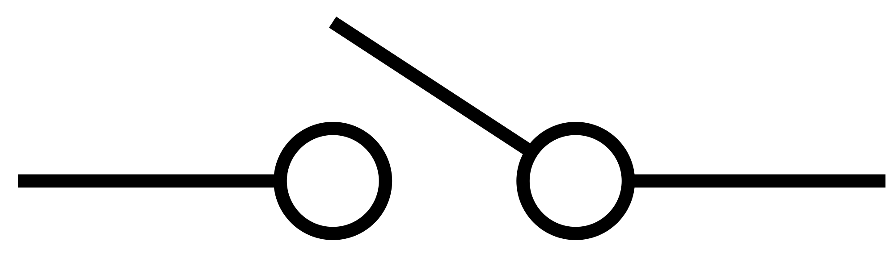
Artificial Neuron - Let's get real!
Neuron
Input1
Connection
weight
Output
Connection
weight
Input2
Activation function
If value is too low, gives 0.
bias
Deep Learning > Artificial Neuron
Notes:
Let me explain what it means by activation function. The role of the activation function is to accept or reject the computed value from weights and bias. It is based on whether the value coming out of the neuron is either too low or too high.

Slide 144
Artificial Neuron - Let's get real!
Input1
Neuron
Connection
weight
Output
Connection
weight
Input2
Activation function
If value is too low, gives 0.
bias
Deep Learning > Artificial Neuron
Notes:
We can simply represent the neuron having the activation function inside it.
An activation function is a mathematical function to convert huge value into something smaller and also very small values into something closer to zero. So, idea is convert the result into zero or one - just like converting an analog signal to a digital signal.

Slide 145
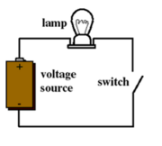
Artificial Neuron - To make it like a electric circuit
Input1
Neuron
Connection
weight
Output
Connection
weight
Input2
bias
Deep Learning > Artificial Neuron
Notes:
To visualize the activation function, imagine a function within the neuron , which works like a switch, which turns a circuit on or off based on the magnitude of the value thats coming out of the neuron.
Thus, the activation function makes the neuron behave like a switch or logic-gate.

Slide 146

Artificial Neuron - To make it like a electric circuit
Input1
Neuron
Connection
weight
Output
Connection
weight
Input2
bias
Deep Learning > Artificial Neuron
Notes:
If we combine a bunch of such neurons and connect to each other - just like that of a series of circuits on a electronic circuit board - we can get a very complex network of neurons that can do amazing predictions.
So, training a neural network is more like automatically coming up with a circuit using data that could give us desired results.

Slide 147
Backpropagation with example
Training a network based on years of work experience as input and Salary as output
Deep Learning > Artificial Neuron > Backpropagation
Notes:
But how would we train such network using historical data? This is done using Back Propagation algorithm. Let’s understand back propagation with an example.

Slide 148
EMP | Work Ex | Salary
emp1 | 4 | 100
emp2 | 5 | 130
emp3 | 2 | 30
emp4 | 5 | 140
Training a network based on years of work experience as input and Salary as output
Deep Learning > Artificial Neuron > Backpropagation
Notes:
Let’s take a dataset with work experience and salary of 4 different employees. We will try to train a neural network with this training data. Here our input features are work experience and label is salary.

Slide 149
EMP | Work Ex | Salary
emp1 | 4 | 100
emp2 | 5 | 130
emp3 | 2 | 30
emp4 | 5 | 140
?
First
?
Second
actual value
Epoch 1
Record 1
?
?
Deep Learning > Artificial Neuron > Backpropagation
Notes:
Here we are taking a simple example of two neurons - we call the left one as first and the right one as second. In this case, we have two weights and two biases meaning we need to tweak these four knobs. We want to come up with positions of the various knobs such that this neural network starts predicting salary based on work experience. Also, to make the calculations simpler, we are not using the activation functions in neurons.

Slide 150
EMP | Work Ex | Salary
emp1 | 4 | 100
emp2 | 5 | 130
emp3 | 2 | 30
emp4 | 5 | 140
Initialize with random weights or knobs.
1.0
0.1
4
100
actual value
Epoch 1
Record 1
50
30
Deep Learning > Artificial Neuron > Backpropagation
Notes:
We go through the initialization phase, where we assign random values to the weights and biases. In this case , we have assigned 1.0 and 0.1 respectively to the weights of the connections of the first and second neuron. 50 and 30 are the biases assigned respectively.

Slide 151
EMP | Work Ex | Salary
emp1 | 4 | 100
emp2 | 5 | 130
emp3 | 2 | 30
emp4 | 5 | 140
Two Neurons - 4 knobs.
Take first record...
?
?
4
100
actual value
Epoch 1
Record 1
?
?
Deep Learning > Artificial Neuron > Backpropagation
Notes:
We take the first record , feed the input from the dataset to the network.
Based on the data that we have
for this record, the expected output is 100.

Slide 152
EMP | Work Ex | Salary
emp1 | 4 | 100
emp2 | 5 | 130
emp3 | 2 | 30
emp4 | 5 | 140
Do the forward pass
1.0
0.1
54
100
4
4*1.0 + 50
actual value
Epoch 1
Record 1
50
30
Deep Learning > Artificial Neuron > Backpropagation
Notes:
We do the forward pass and calculate the value of the intermediate stage i.e , value after the first neuron. This value is 54 in this case - 4 multiplied by 1 and added with 50.

Slide 153
EMP | Work Ex | Salary
emp1 | 4 | 100
emp2 | 5 | 130
emp3 | 2 | 30
emp4 | 5 | 140
Do the forward pass
1.0
0.1
54
100
4
35.4
Computed value
actual value
54*0.1 + 30
Epoch 1
Record 1
50
30
Deep Learning > Artificial Neuron > Backpropagation
Notes:
The output from the first neuron goes in as the input for the second neuron and based on the weight and bias, the final value is calculated here we multiple 54 with 0.1 and added 30.

Slide 154
EMP | Work Ex | Salary
emp1 | 4 | 100
emp2 | 5 | 130
emp3 | 2 | 30
emp4 | 5 | 140
Compute the error
1.0
0.1
54
100
4
35.4
{
Computed value
actual value
Epoch 1
Record 1
|| 100 - 35.4 ||
50
30
Deep Learning > Artificial Neuron > Backpropagation
Notes:
We now calculate the error
based on the the computed value and the actual value. Remember, this is called the forward pass stage.

Slide 155
EMP | Work Ex | Salary
emp1 | 4 | 100
emp2 | 5 | 130
emp3 | 2 | 30
emp4 | 5 | 140
Back Pass: Tweak the knob of the second neuron
1.0
0.2
54
100
4
35.4
Computed value
actual value
Epoch 1
Record 1
50
50
Deep Learning > Artificial Neuron > Backpropagation
Notes:
Now freezing the first set of knobs, i.e the weight and bias on the first neuron, we tweak the values of the weight and bias of the second neuron.

Slide 156
EMP | Work Ex | Salary
emp1 | 4 | 100
emp2 | 5 | 130
emp3 | 2 | 30
emp4 | 5 | 140
Back Pass: Freeze the second knob, tweak the knob of the first neuron
2.0
0.2
54
100
4
35.4
Computed value
actual value
Epoch 1
Record 1
40
50
Deep Learning > Artificial Neuron > Backpropagation
Notes:
Next, we go one step backward and tweak the value of the weight and bias of the first neuron by keeping the weight and bias of the second neuron frozen. This, you might recall, is called the back pass.

Slide 157
EMP | Work Ex | Salary
emp1 | 4 | 100
emp2 | 5 | 130
emp3 | 2 | 30
emp4 | 5 | 140
Next Record. Repeat the process,
Tweak the weights...
2.0
0.2
50
130
5
55
Computed value
actual value
Epoch 1
Record 2
40
50
Deep Learning > Artificial Neuron > Backpropagation
Notes:
We repeat the same process all over again, by feeding the second record to the network.. Please note that we don't re-initialize the weights before picking up the next instance because, we don’t want to lose the learning from the previous instance.

Slide 158
EMP | Work Ex | Salary
emp1 | 4 | 100
emp2 | 5 | 130
emp3 | 2 | 30
emp4 | 5 | 140
Next Record. Repeat the process,
Tweak the weights...
3.0
0.25
51
30
2
67.75
Computed value
actual value
Epoch 1
Record 3
45
55
Deep Learning > Artificial Neuron > Backpropagation
Notes:
.. And then we do the same for third record ...

Slide 159
EMP | Work Ex | Salary
emp1 | 4 | 100
emp2 | 5 | 130
emp3 | 2 | 30
emp4 | 5 | 140
Next Record. Repeat the process,
Tweak the weights...
3.5
0.2
64.5
140
5
65.2
Computed value
actual value
Epoch 1
Record 4
47
40
Deep Learning > Artificial Neuron > Backpropagation
Notes:
And then fourth record.

Slide 160
EMP | Work Ex | Salary
emp1 | 4 | 100
emp2 | 5 | 130
emp3 | 2 | 30
emp4 | 5 | 140
Next Epoch. Begin again from the first record ...
4.0
0.21
67
100
4
54.07
Computed value
actual value
Epoch 2
Record 1
51
41
Deep Learning > Artificial Neuron > Backpropagation
Notes:
At every stage, the weights and biases of the neurons are fine tuned based on the difference in the actual and computed errors.
When all the records in the dataset have gone through the process, we say that it has completed an epoch. We now start again from the first record. This is called the second epoch. Note that we DONOT reinitialize the weights and bias when we start a new epoch. The weights and the bias from the previous epocs get carried forward to the subsequent epocs.

Slide 161
EMP | Work Ex | Salary
emp1 | 4 | 100
emp2 | 5 | 130
emp3 | 2 | 30
emp4 | 5 | 140
Epoch #2 , Second Record, and so on.
5.0
0.1
75
130
5
52.5
Computed value
actual value
Epoch 2
Record 2
50
45
Deep Learning > Artificial Neuron > Backpropagation
Notes:
We continue this process as long as the overall error is going down.

Slide 162
EMP | Work Ex | Salary
emp1 | 4 | 100
emp2 | 5 | 130
emp3 | 2 | 30
emp4 | 5 | 140
emp5 | 6 | ??
Once it has been trained, it is ready to do the predictions
4.75
0.215
6
???
Predicted value
42.25
43.12
Deep Learning > Artificial Neuron > Backpropagation
Notes:
Once the epochs are completed, we say that we have trained the network with our data. We are now ready for predicting the salary of a new employee whose number of years of experience is known.

Slide 163
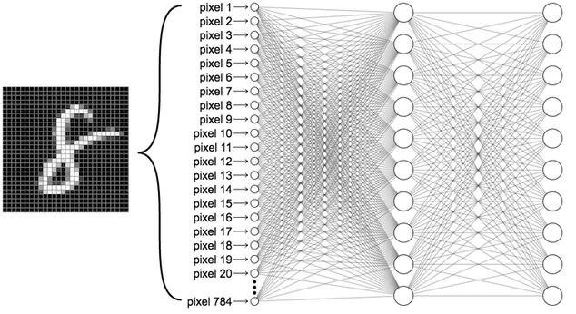
ANN or Fully connected Neural Network
MNIST - classifying a handwritten image into 10 labels.
Labels
0
1
2
3
4
5
6
7
8
9
Deep Learning > Artificial Neuron > ANN
Notes:
Lets extend the use of neural network onto the MNIST dataset. Assume we have an instance of an image of digit 8.
The task of the network is to identify the image as one of the 10 digits , 0 to 9, and assign it to the corresponding label.
We have 784 pixels in this image. Each pixel is an input to the network. And we have 10 outputs labelled 0 to 9.

Slide 164
Training Neural Network - MNIST
It would basically compute probabilities of various digits
Probabilities
Labels
.001
0
.001
1
0.04
2
0.06
3
0.03
4
0.1
5
0.07
6
0.01
7
0.6
8
0.07
9
Deep Learning > Artificial Neuron > ANN
Notes:
In such cases, where we are doing classification, we want the neural network to give out the probabilities. Here you can see that the network has predicted the highest probability i.e. 0.6 and therefore assigned it to the label 8.

Slide 165
Training Neural Network - MNIST
How to train it?
Probabilities
.001
.001
0.04
0.06
0.03
0.1
0.07
0.01
0.6
0.07
Deep Learning > Artificial Neuron > ANN
Notes:
Lets understand how this training was done, keeping in mind the same process of forward and backward pass that we saw earlier.

Slide 166
ANN or Fully connected Neural Network
Step 1 - Initialize the weights
Actual
Labels
0
0
0
1
0
2
0
3
0
4
0
5
0
6
0
7
1
8
0
9
Deep Learning > Artificial Neuron > ANN
Notes:
Just like the earlier example with 2 neurons, we initialize the weights and the biases of all the neurons in all layers.

Slide 167
Training Neural Network - MNIST
Take an instance from training data.
Actual
Labels
0
0
0
1
0
2
0
3
0
4
0
5
0
6
0
7
1
8
0
9
Deep Learning > Artificial Neuron > ANN
Notes:
As a first step, we take the first instance, and then feed the inputs ( the pixel values ) to the 784 input neurons. The expected output, that is , the actual probability of the drawing of digit 8 is 1 while the other digits are 0.
The exper

Slide 168
ANN or Fully connected Neural Network
Step 2 - Forward pass
Actual
Labels
0
0
0
1
0
2
0
3
0
4
0
5
0
6
0
7
1
8
0
9
Deep Learning > Artificial Neuron > ANN
Intermediate values
Notes:
We calculate the intermediate values or probabilities
at the second layer
based on the weights assigned to the neurons and the biases.

Slide 169
ANN or Fully connected Neural Network
Step 2 - Forward pass
Actual
Labels
0
0
0
1
0
2
0
3
0
4
0
5
0
6
0
7
1
8
0
9
Deep Learning > Artificial Neuron > ANN
Notes:
and then to we calculate the result final layer.

Slide 170
ANN or Fully connected Neural Network
Step 2 - Forward pass
Computed
Actual
Labels
.1
0
0
.1
0
1
0.05
0
2
0.15
0
3
0.11
0
4
0.99
0
5
0.1
0
6
0.18
0
7
0.02
1
8
0.1
0
9
Deep Learning > Artificial Neuron > ANN
Notes:
After the forward pass stage, we get the computed value for each label.

Slide 171
ANN or Fully connected Neural Network
Step 2 - Forward pass
Computed
Actual
Labels
.1
0
0
.1
0
1
0.05
0
2
0.15
0
3
0.11
0
4
0.99
0
5
0.1
0
6
0.18
0
7
0.02
1
8
0.1
0
9
Deep Learning > Artificial Neuron > ANN
Notes:
And find the error between the computed and the actual probabilities.

Slide 172
ANN or Fully connected Neural Network
Step 3 - Back Pass - Second Layer
Computed
Actual
Labels
.1
0
0
.1
0
1
0.05
0
2
0.15
0
3
0.11
0
4
0.99
0
5
0.1
0
6
0.18
0
7
0.02
1
8
0.1
0
9
Frozen
Layer
Deep Learning > Artificial Neuron > ANN
Notes:
We now tweak the weights of the last layer by freezing the values of weights and biases of the other layers using gradient descent technique.

Slide 173
Training Neural Network - MNIST
Step 2 - Forward pass
Predicted
Actual
Labels
.1
0
0
.1
0
1
0.05
0
2
0.15
0
3
0.11
0
4
0.99
0
5
0.1
0
6
0.18
0
7
0.02
1
8
0.1
0
9
Frozen
Layer
Deep Learning > Artificial Neuron > ANN > Training
Notes:
Now we move to the previous layer, in this case it is the first layer. We tweak the weights and biases of the first layer keeping the second layer frozen using gradient descent.

Slide 174
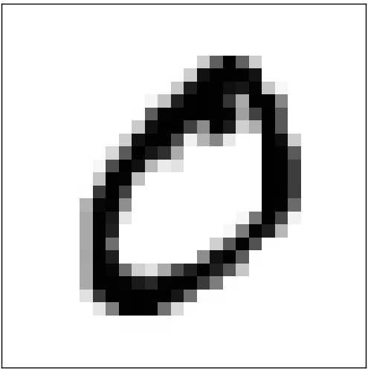
Training Neural Network - MNIST
Pick next instance
Predicted
Actual
Labels
.45
1
0
.01
0
1
0.03
0
2
0.25
0
3
0.01
0
4
0.03
0
5
0.02
0
6
0.1
0
7
0.01
0
8
0.1
0
9
Deep Learning > Artificial Neuron > ANN > Training
Notes:
Once we are done tweaking the weights and biases of both the layers, we move on to the next instance. In this case we have shown that we picked 0. Now, the pixel values of zero will be fed to the neural network and the weights will be tweaked further such that the actual values match the predicted values.

Slide 175
Training Neural Network - MNIST
Next Iteration or epoch
Predicted
Actual
.1
0
.1
0
0.05
0
0.15
0
0.11
0
0.99
0
0.1
0
0.18
0
0.02
1
0.1
0
Deep Learning > Artificial Neuron > ANN > Training
Notes:
After first round of training with all the instances data, we start the next iteration round from beginning without resetting the weights and biases.
The iteration is also known as epoch.
We keep the iterations going on as long as the overall error keep going down. If the error is no longer going down we stop iteration.
This is how we train a neural network network to recognize the images. A similar strategy can be applied to recognize faces and to identify the speech and more…
We may not be able to visualize how exactly the neural network is doing the magic or how the weights values impact the outcome. Though we can think of a neural network as a whole like a electronic circuit which is auto created in order to achieve the desired outcome.
The weights and the biases along with the number of layers, number of neurons that are present in each layer and how neurons are connected defines the architecture of the network.

Slide 176
Summary
Notes:
In this session, we covered how

Slide 177
Linear Regression
Summary
Notes:
linear regression

Slide 178
Linear Regression
Decision Trees
Summary
Notes:
decision trees

Slide 179
Linear Regression
Decision Trees
SVM
Summary
Notes:
SVM and

Slide 180
Linear Regression
Decision Trees
SVM
Neural Networks
Summary
Notes:
neural networks actually work. We can combine and improvise on these approaches to get even better results which we will be discussing in the next chapter

Slide 181
Questions?
https://discuss.cloudxlab.com
reachus@cloudxlab.com
Notes:
I hope you like this session. Thank You.

